Slide 2
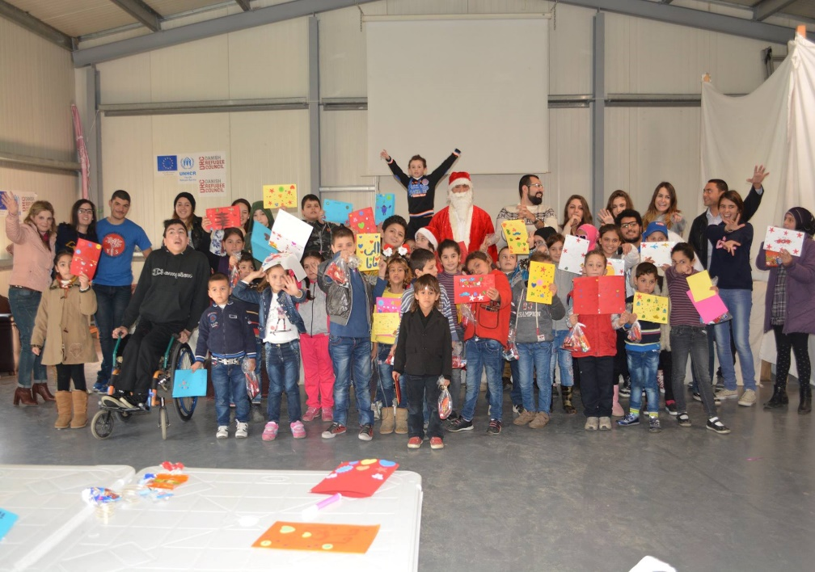
YES Alumni Networks:
Volunteer Management & Community Engagement

Slide 3
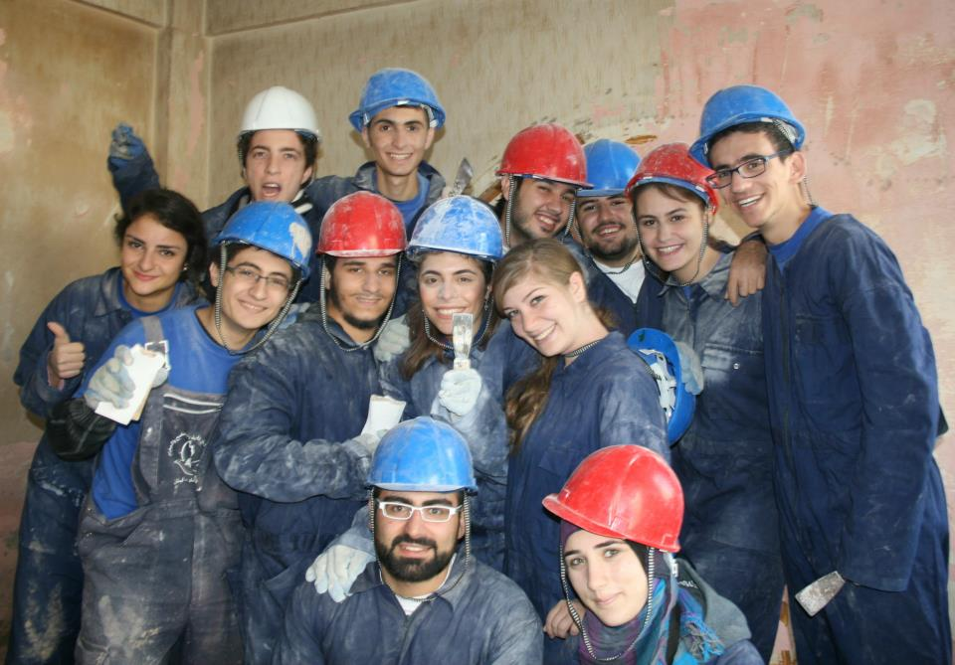
Outline
Effective Volunteer Management Techniques
Alumni Activities for Better Community Engagement
How to Lead Successful Projects
How to Attract Volunteers for a Project Implementation
How to Guarantee Buy-in for a Project

Slide 4
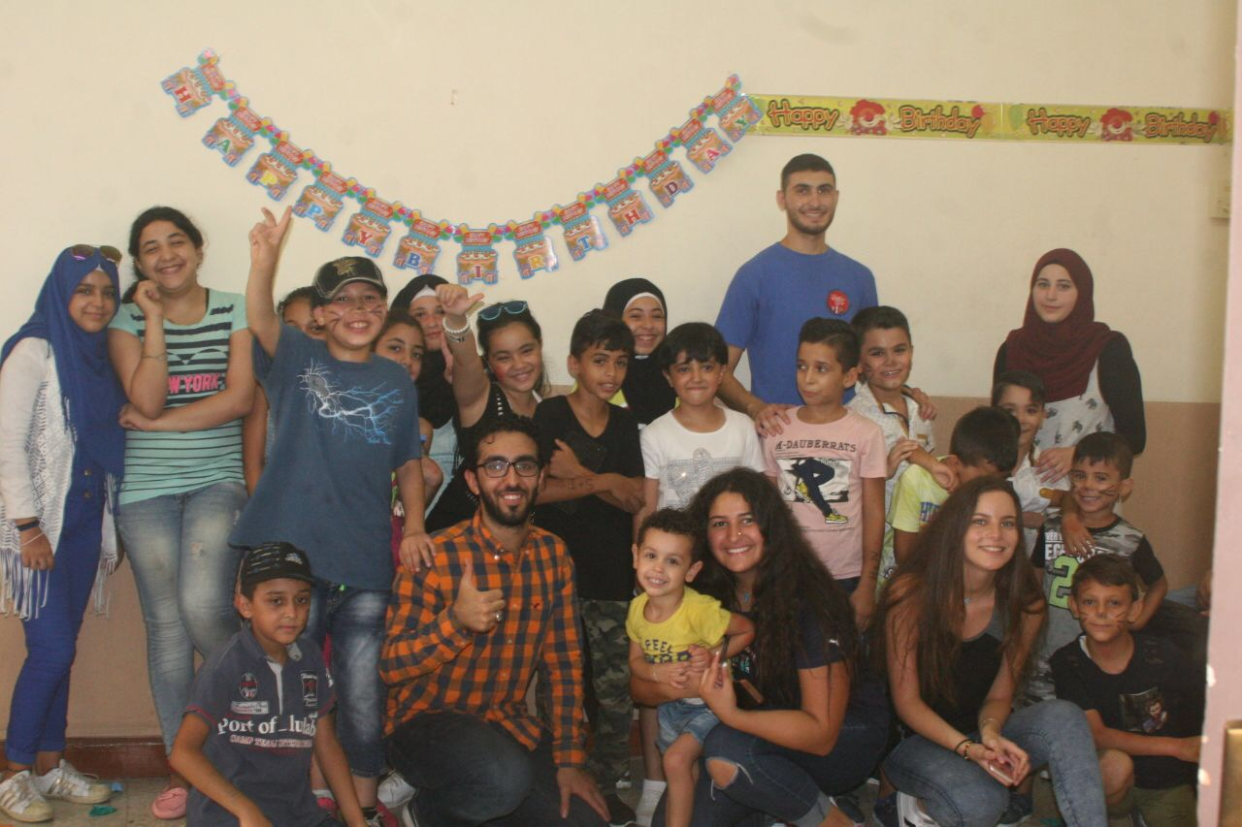
Effective Volunteer Management Techniques
Why is effective volunteer management important?
Higher number of volunteers engaged
Increased success rate of projects
Build trust with communities → more buy-in for projects

Slide 5
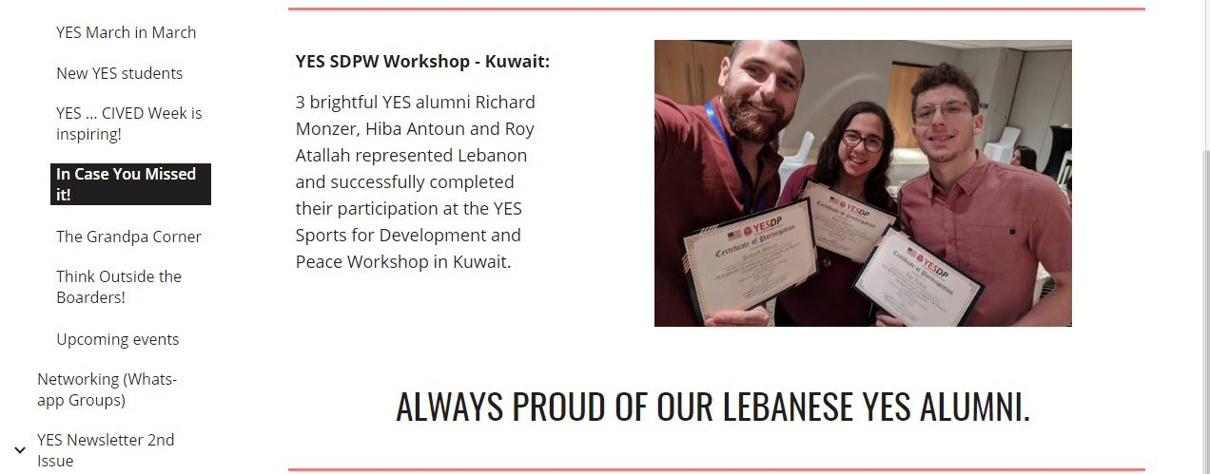
Effective Volunteer Management Techniques
Build an alumni network/association, or any organized structure
Identify key volunteers & their areas of expertise
Create a volunteer recognition system: among alumni network, community, social media platforms, etc.

Slide 6
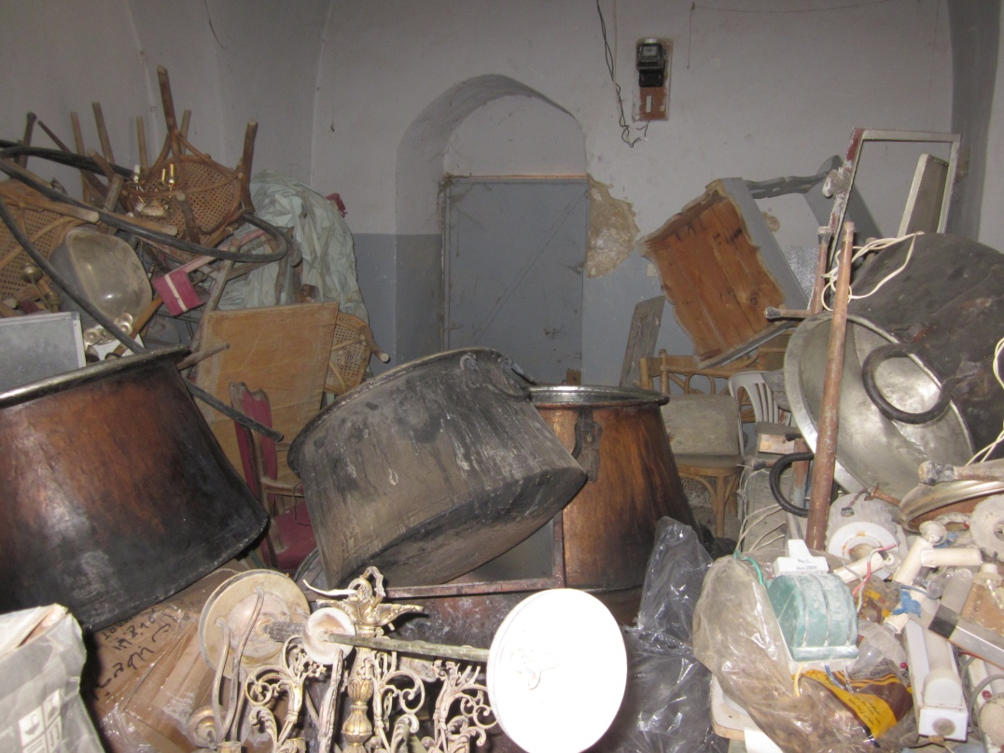
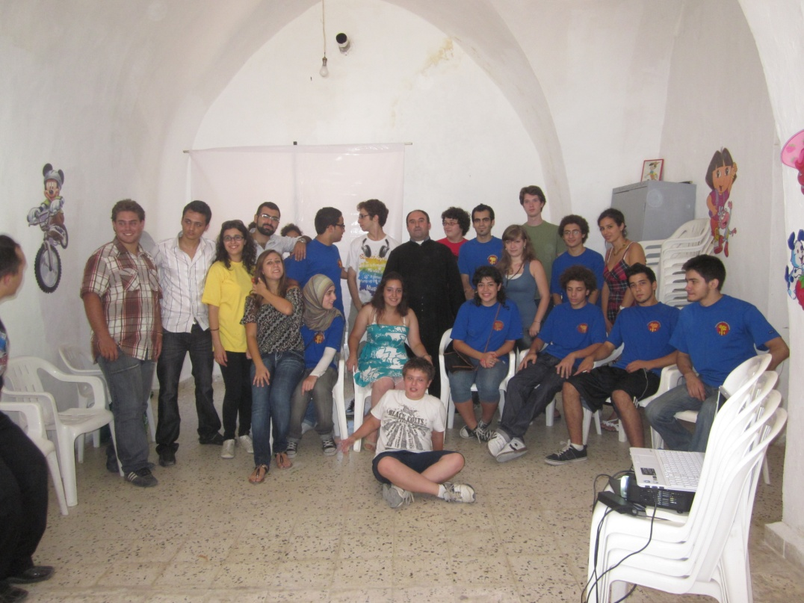
Alumni Activities for Better Community Engagement
Asses community needs: ask community leaders, interview local residents, check trends
Implement diverse projects serving different target groups
Implement projects with long-term sustainability (i.e. establishing local libraries)
Before
After

Slide 7
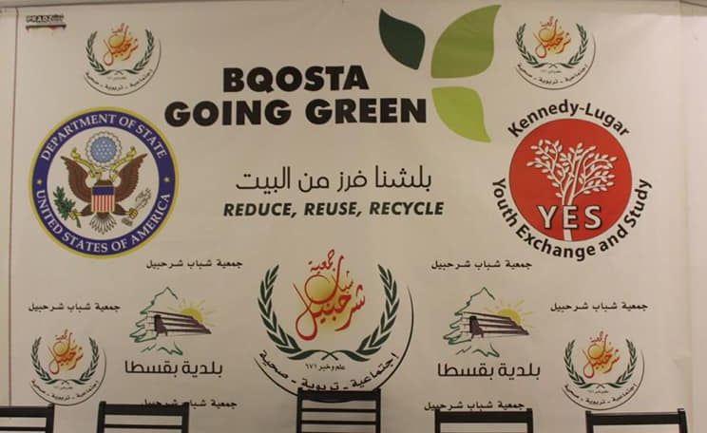
How to Lead Successful Projects
Structure, Structure, Structure!
Create Subcommittees for each project: leader, social media coordinator, financial coordinator, stakeholders coordinator, etc.
Coordinate with local/international NGOs
Involve community members, especially leaders

Slide 8
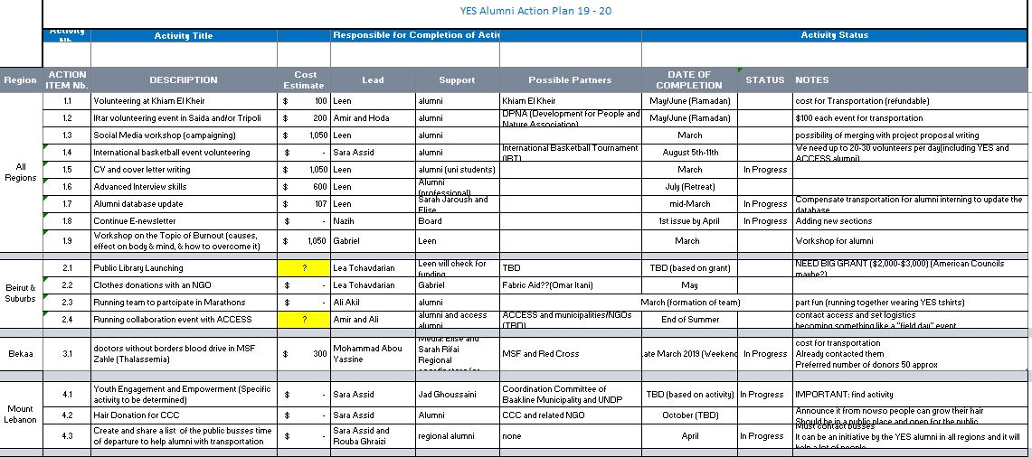
How to Lead Successful Projects
Create action plans and trackers

Slide 9
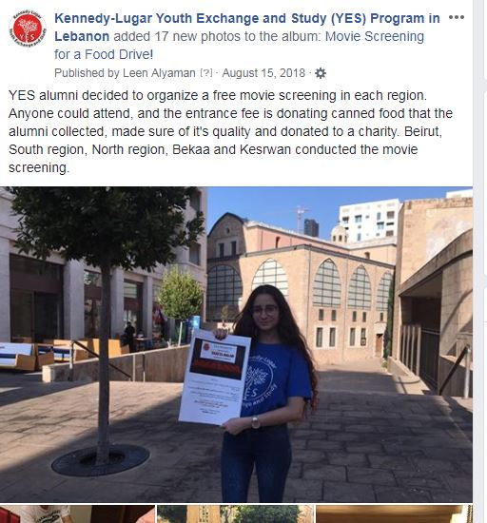
How to Attract Volunteers for a Project Implementation
Ask them what causes they care about
Social media coverage & recognition
Emphasize social impact of project on the local community

Slide 10
How to Guarantee Buy-in for a Project
Get organized!
Provide clear implementation & follow-up plans
Collaborate with local/international NGOs/companies, municipalities

Slide 11
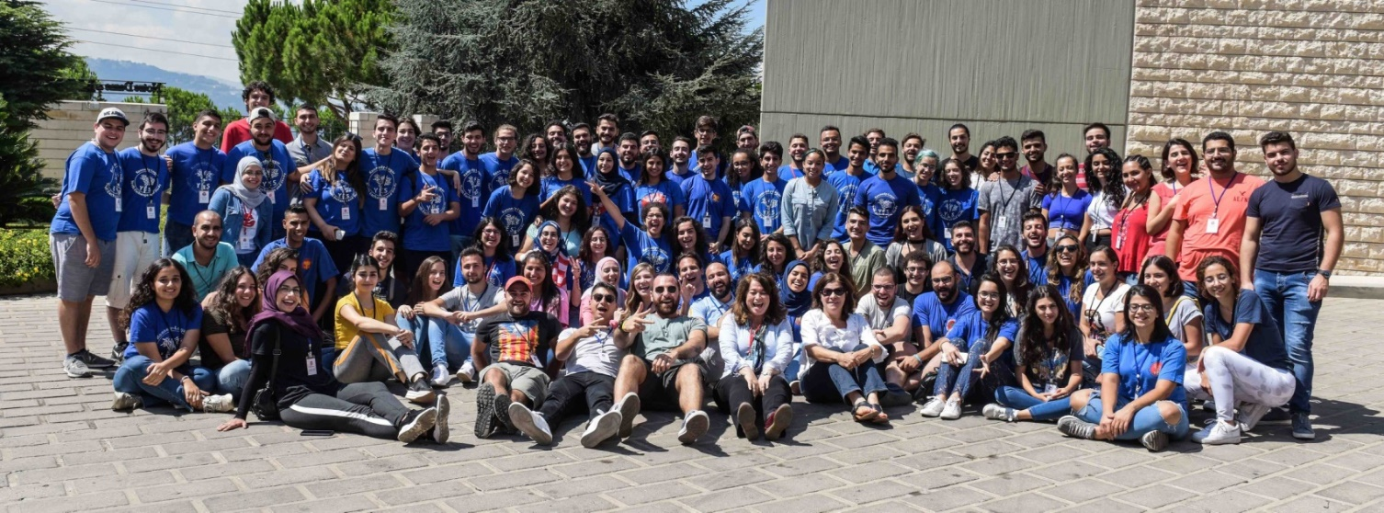
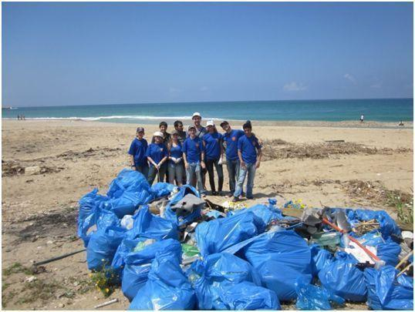
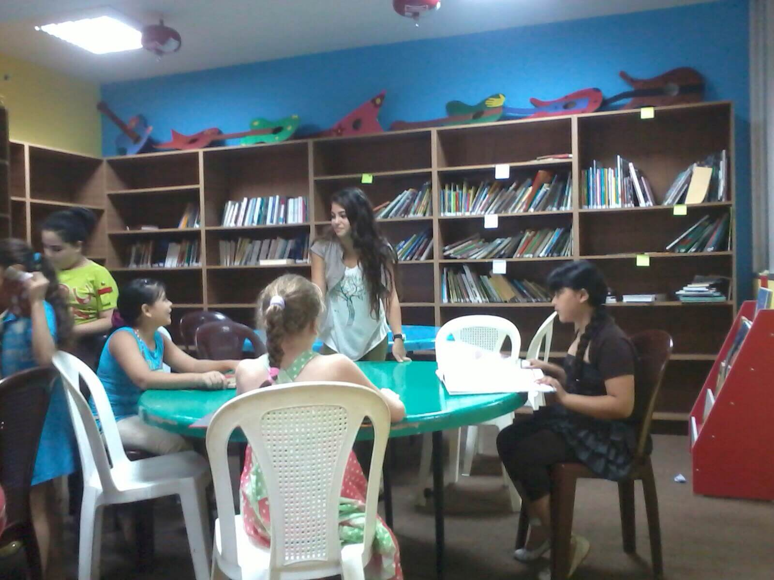
“Life’s most persistent and urgent question is, what are you doing for others?”
- Martin Luther King, Jr.
Thank you!

Slide 12
1
Constituents
Your constituents are all members of your community who are impacted by the change you are trying to create.
Who in your community is impacted by the issue being addressed in your GYSD project?
2
3
4
5

Slide 13
2. Base
Your base is made up of your community members who are both impacted by the issue you are working with, and educated on the issue.
What spaces in your community have untapped potential for learning and growth?
1
2
3
4
5

Slide 14
3. Members
Your members are those in your community who are ready to take action to make change.
What skills exist in your community that may not be utilized right now? How can you encourage them?
1
2
3
4
5

Slide 15
4. Leaders
Leaders are those taking charge in putting together actions for change. They are typically the face of movements.
How do you as a leader, acknowledge leadership in every level of the target?
1
2
3
4
5

Slide 16
5. Community Organizer
Community Organizers develop their community members through the different levels of involvement in their community.
What do you value most, and how can you share that value with the community around you?
1
2
3
4
5

Slide 17
Register your projects at http://leadasap.ysa.org/gysd/
https://www.yesprograms.org/
http://www.yes-abroad.org/
@yes.program
@yesabroad
@Youth Exchange and Study
@KLYESAbroad
@yesprogramnews
@KLYESAbroad

