Slide 1
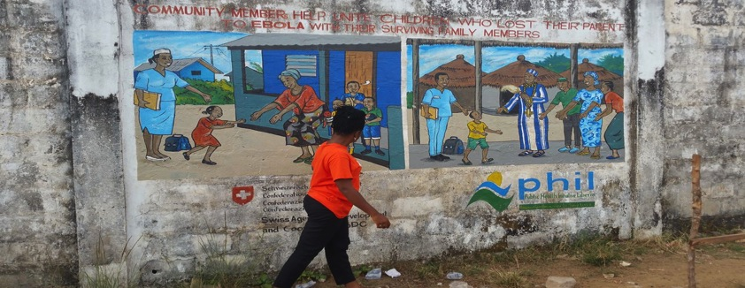
Community Health Webinar
Presentation by: Mrs. Joyce Kilikpo Jarwolo
Executive Director Public Health Initiative Liberia
Date: July 25th 2016

Slide 2
Table of content
Definitions of terms –Community and Community health
Steps in establishing a community health project
Tips for getting funding
About PHIL
PHIL Key Programs
Opportunities to engage in community health

Slide 3
Overview of community health
Community is defined as a group of inhabitants living in somewhat localized area under the same general regulations and having common norms, values, and organizations – Green and Ottoson, 1999)
Community Health refers to the health status of a defined group of people and actions and conditions , both private and public ( government) to promote and protect and preserve their health- McKenzie et al, 2005
Notes:
The field of community health is anchored in a rich history of innovations in public health methods and programs directed at reducing risk factor prevalence, decreasing acute and chronic disease burden and injury occurrence and promoting health

Slide 4
Steps in starting a community health project
Step1
Before you begin your project it is important to Identify or discover the issues facing your community in terms of health by visiting the nearest health facilities.. if there are are already activities ongoing or project being implemented in your community perhaps you can join in
Step 2
Once you have identify the issues conduct an assessment , this can be either survey or a focus group discussion on the issues so as to understand why and how you could mobilize your community to address the issue idenitified

Slide 5
Steps Continue
Step 3
Analyse your report and finalize your ideas
Step4
Establish or work with a community group if non is existing to implement your ideas
Step 4
Contact organizations or people with expertise to help you organize your ideas along with your community group.

Slide 6
Steps Continue
Step 5
Plan your project
As a group write down your goals- what do you want to achieve, how will you achieve it and when do you hope to achieve it ? Who are you going to target. Make your Objectives SMART
S- make it Specific
M- Measureable
A-Achievable( Don’t be over ambitious)
R-Realistic
T-Time bound ( Set deadlines to help guide and focus your activities

Slide 7
Steps Continue
Step 6
Identify how you will fund the activities. Funding can be an issue for any community project but will depend on the activities you want to undertake
You could do a simple fund raising event such as car wash

Slide 8
Tips for funding
Define a need for funding( eg improving health of your community, or preventing teenage pregnancy among adolescent girls
Identify shared goals with the institution you are seeking funding from
State what is it you have or bring to the table ( human resource, network of motivated & committed volunteers)
State your status: are you a registered legal non governmental organization,
Do you have a board, who are those on your board
Do you have an office space or physical address

Slide 9
Steps continue
Step 7
Publicity
Once you have plan your project , you need to promote it to the wider community before, during and after the project implementation

Slide 10
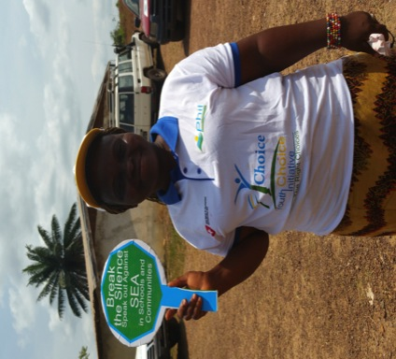
About PHIL
PHIL Stands for Public Health Initiative Liberia
Established in 2011 with the mission to promote and enhance the quality of health service delivery through leadership, partnership, innovation and capacity building

Slide 11
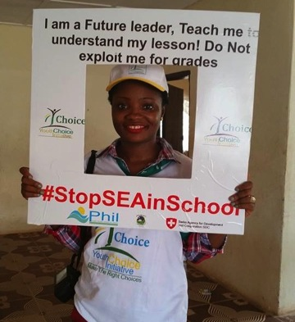
PHIL’s key Programs
Integrated community Based Health Service Delivery
Accountability in Health Care
Research and Advocacy
Adolescent sexual and reproductive Health- Youth Choice Initiative (Y-Choice)
Water Sanitation and Hygiene ( WASH)

Slide 12
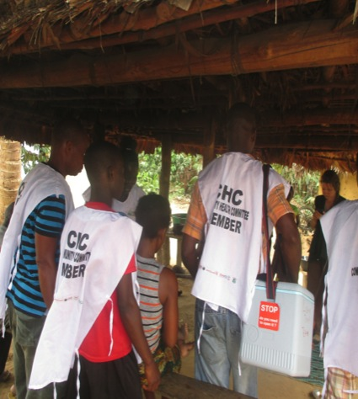
Current interventions
Integrated community Based Health Service Delivery- work on issues of maternal, new born , child and reproductive health through mothers club, community health committees- key issues targeted are Malaria, Diarrhea, prevention of death in pregnancy, HIV& AIDS, Tuberculosis, Family Planning, Vaccination, etc

Slide 13
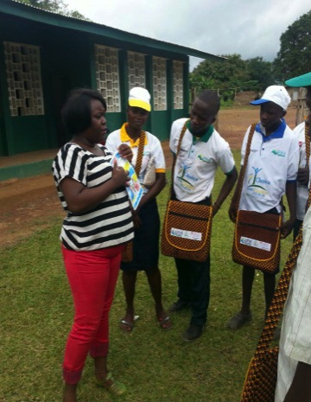
Key Programs cont.’
Adolescent sexual and reproductive health- is a program design by young people to address sexual and reproductive health issues affecting young people. It is a platform use to engage service providers, policy makers and mobilize young people to take action in making choices that affect their health

Slide 14
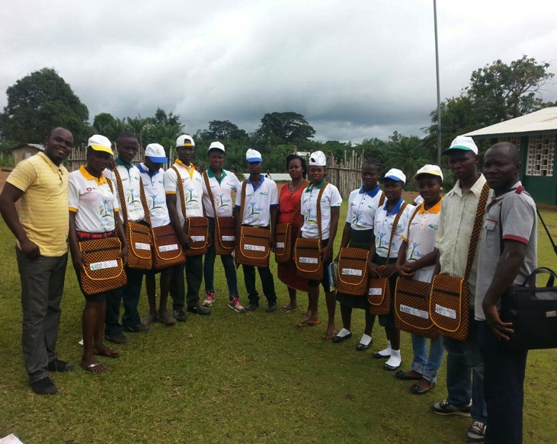

Slide 15
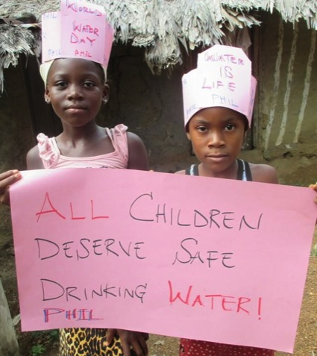
Key Programs cont’
Water , Sanitation and Hygiene-WASH; Works through school clubs and communities to promote access to safe drinking water, sanitations and hygiene among school kids and their communities

Slide 16
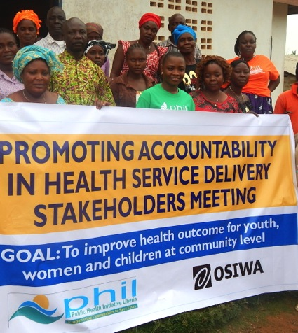
Key Programs Cont.
Accountability in Health care- works through community structures called the health accountability committees using human right based approach to improve health services,

Slide 17
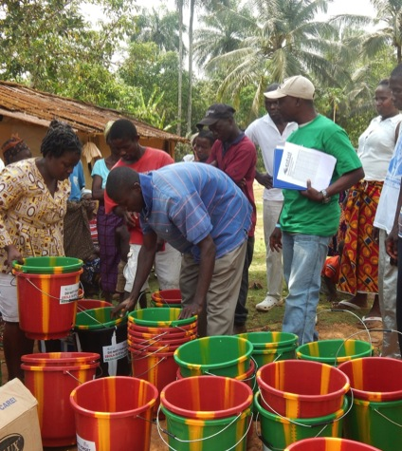
Opportunities for engaging in community health
Sign up to serve as community health volunteer

Slide 18
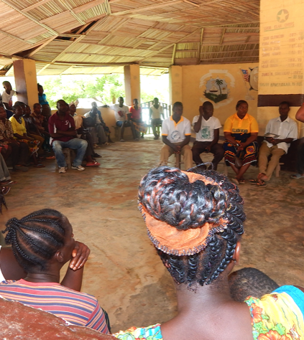
Opportunities to engage in community health
Link/ connect with local health services providers / organizations in your community
identify how your skills and knowledge would help in addressing health issues in your community

Slide 19
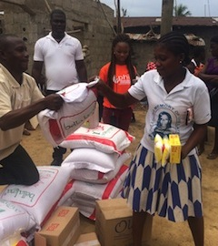
Opportunity to engage in community health
Serve as local volunteer during emergencies

Slide 20
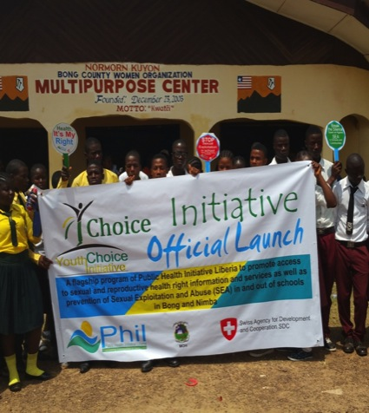
Opportunities to engage in Community Health
Sign up as Peer educator in your community

Slide 21
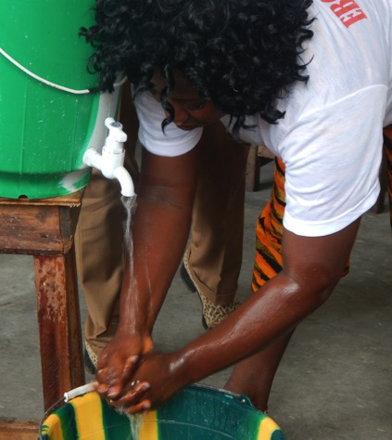
Opportunities to engage in Community Health
Take actions in your home and community to promote health and well being

Slide 22
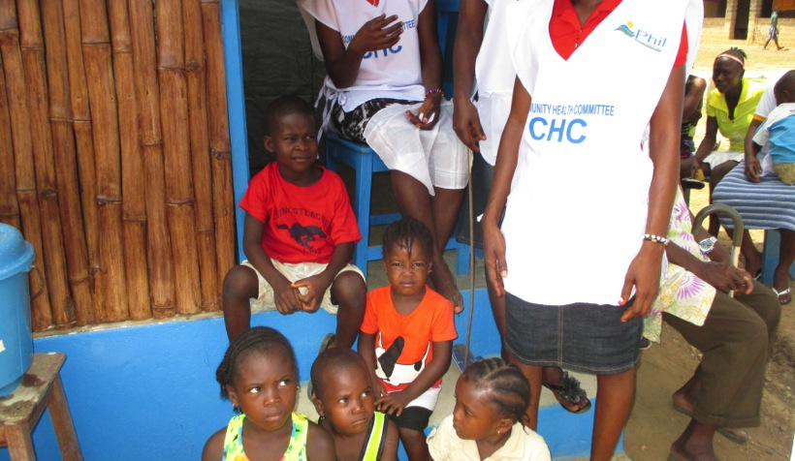
Thank You!
Questions???

