Slide 1
My experience with Evaluation
By
Marouane Smaili – Agadir, Morocco
YES Alumnus 2007-2008; Host City: Tucson, Arizona
Masters Degree in Marketing & Sales Operations from ENCG Business School
Google Student Ambassador at Ibn Zohr University
Communication Officer and Project Manager at Dar Si Hmad NGO

Slide 2
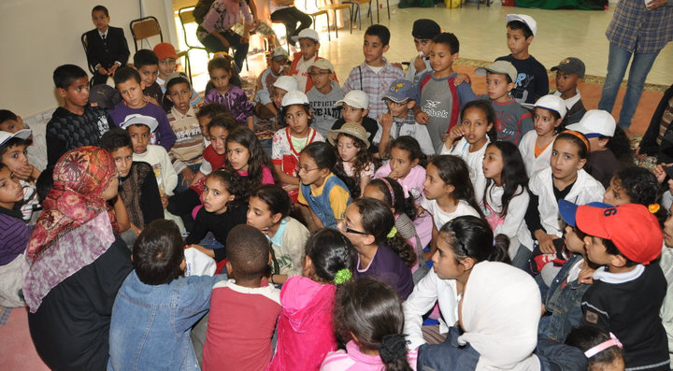
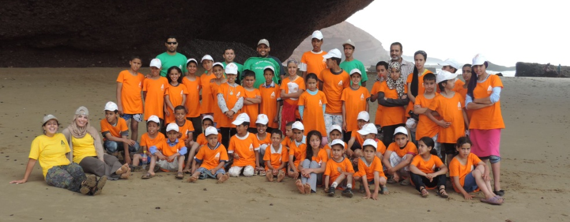
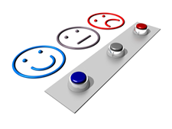
What I'd like to share with you today
Water School: A successful project. Time to evaluate!
Happy Day I and II: moving forward with no evaluation - outcome
1
2
3
Tips when evaluating your projects

Slide 3
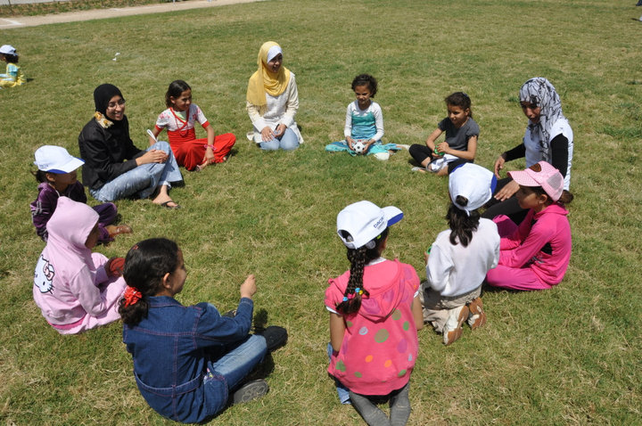
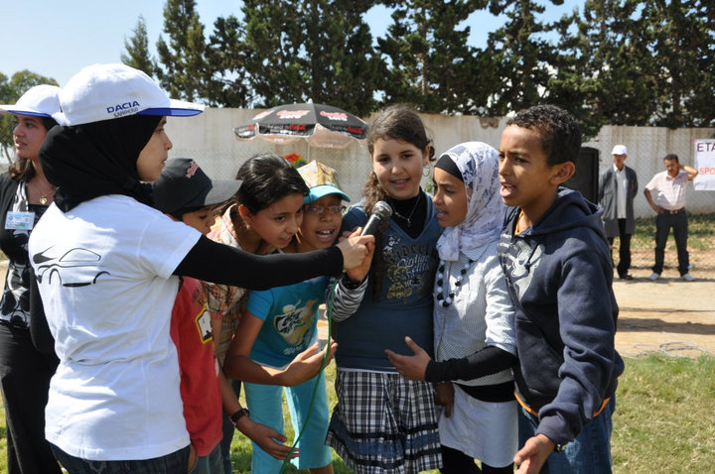
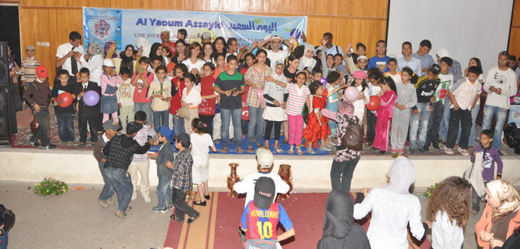
Happy Day I and II: moving forward with no evaluation - outcome
Notes:
A full-day event of fun and educational workshops for 100 orphans and children raised in marginalized neighborhoods in the region of Agadir (Southwest Morocco) organized in May and December 2010.

Slide 4
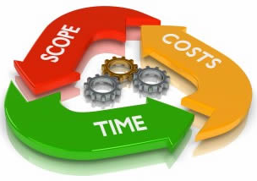
Happy Day project phases:
Preparation/Planning: selecting a team, setting goals and deliverables, dispatching tasks, Sponsor visits, logistics, communication...
Implementation: Receiving guests, running workshops (dance, general knowledge, theatre, games...)
- Evaluation: None!
Notes:
(we prepared a narrative short report with no critical views, purely descriptive)

Slide 5
Errors that could have been avoided in Happy Day II if we evaluated the first event
- Lunch: Excess in the number of guests (conflict with the catering company)
- Time keeping: Late to begin and late to finish
- Sponsoring folder: No major updates or improvement, less money in.
- Budget: It was overly inflated and was kept as such. Less money in from sponsors.

Slide 6
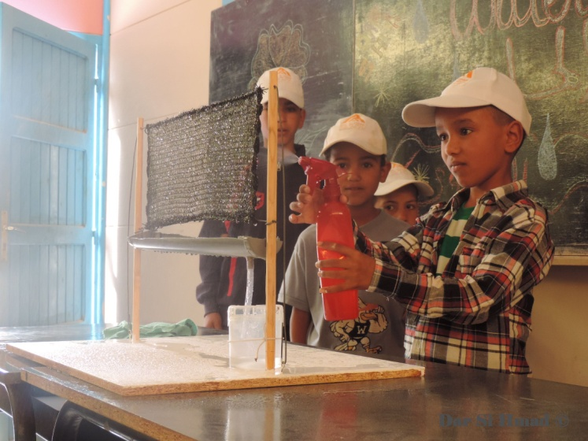
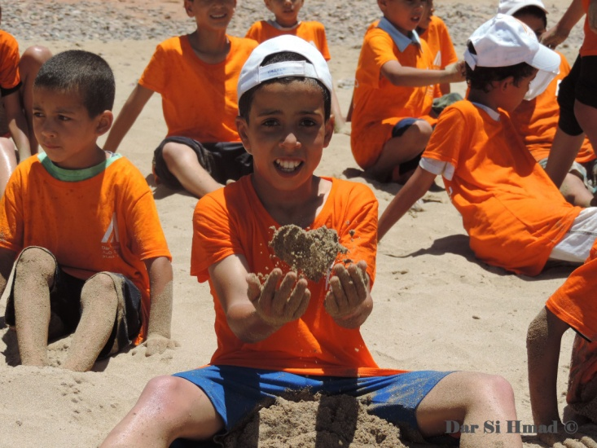
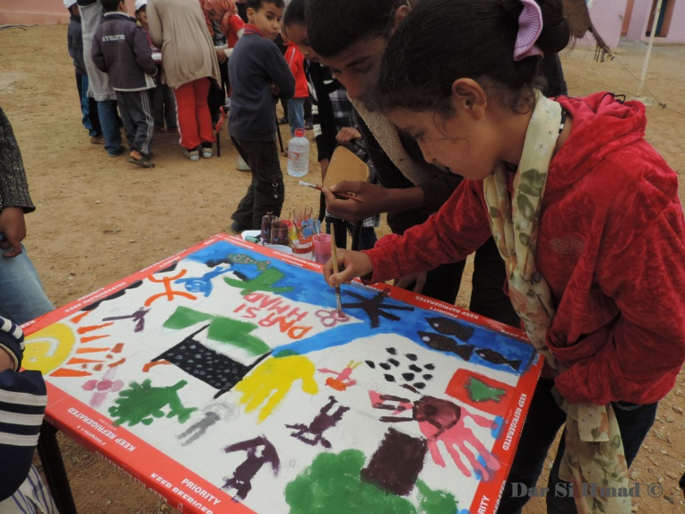
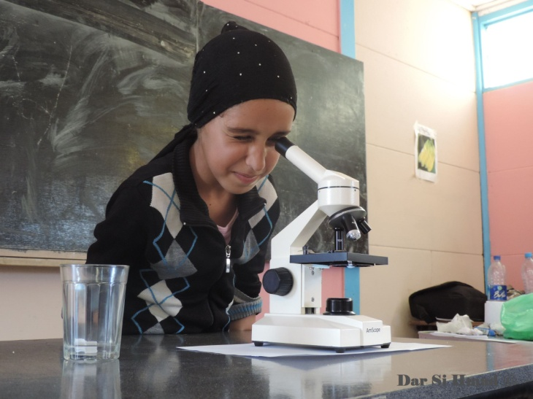
Water School 2014: A successful project. Time to evaluate!
Hands-on workshops,
Experiments,
Visit to the ocean,
Scientific trips,
Discussions,
Technology day
...
Notes:
A three-week summer camp for 46 rural children in Southwest Morocco (6-13 years old) around the themes of water and the environment.

Slide 7
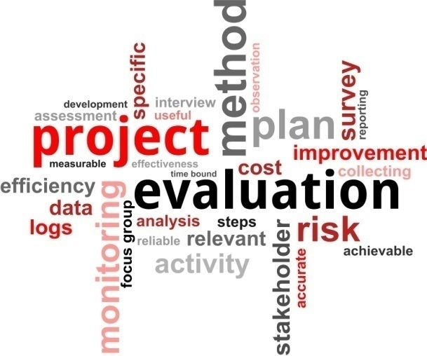
Water School Evaluation
Unstructured
Structured
Random questions
Small sample
Biased approach
Research aspects: Management and Staff, Curriculum quality, Food, Program length...
Tools: Questionnaires, interview guides
Sample: direct beneficiaries 30 children, stakeholders: Parents, local teachers, Project Committee
Budget + Timeline

Slide 8
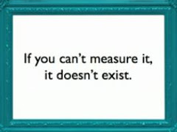
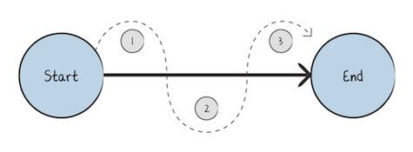
Tips when evaluating your projects
Think evaluation from the start:
Set SMART goals that reflect what you want to achieve with you project, imagine the desired outcome in your head and jot down how it looks like in terms of goals
- Be efficient:
Let one person or two coordinate the evaluation process, some can help design or test questionnaires, others can help with data collection and analysis. But one or two should follow-up and bring the pieces of the puzzle together.
Notes:
. (Next thing is setting indicators to evaluate your goals)

Slide 9
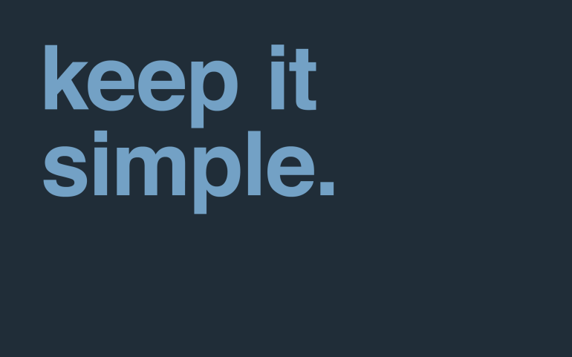
Tips when evaluating your projects
Don't think evaluation is only for big projects
(remember happy day I & II)
Evaluation is a phase of project management, a project isn't completed without it.
- Make it simple
Define your project, set your goals and performance indicators, dispatch tasks as a team, establish a timeline, Mobilize financial/material resources, Action! Evaluate as you go, and evaluate after the project :)

Slide 10
Thank you for your attention ☺ ☺ ☺

